Slide 1
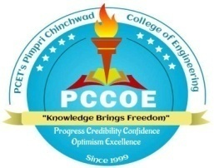
Pimpri Chinchwad Education Trust (PCET) Pimpri Chinchwad College of Engineering NBA Accredited | NAAC Accredited with 'A' Grade | An Autonomous Institute | AICTE Approved | ISO 21001:2018An
Department of Computer Engineering
5G vs 6G Technology
Presented By
Kshitij R. Magare
(123M1B007)
Guided By
Dr. G. B. Sambare

Slide 2
Contents
Problem Statement
Motivation
Objectives and Scope of the Project
2

Slide 3
Problem Statement
To compare the real-world impact of 5G technology with the advancements of 6G, given that 5G is actively being deployed and 6G is still in the research phase.
To understand the key differences in the technological advancements of 5G and 6G, and how do these differences influence their respective capabilities and applications.
3

Slide 4
Motivation
Rapid Evolution:
The continuous evolution of wireless technology demands a clear understanding of each generation’s advancements to better prepare for future developments.
Impact on Industries:
Understanding the differences between 5G and 6G is crucial for industries that will be significantly affected by these technologies, such as telecommunications, healthcare, automotive, and smart cities.
4

Slide 5
Objectives and Scope
Compare Technologies:
To provide a comprehensive comparison of 5G and 6G technologies, highlighting their key differences in terms of speed, latency, connectivity, and potential applications.
Identify Advancements:
To analyze the advancements that 6G technology is expected to bring over 5G, including new use cases, enhanced capabilities, and emerging technologies.
Examine Challenges and Opportunities:
To explore the challenges and opportunities associated with changing from 5G to 6G, including technological, economic, and regulatory considerations.

Slide 6
Thank You

